Slide 1

PowerShell on Linux: What’s the Big Deal?
>_
#!
Presented by:
Adam the Automator

Slide 2

Your Guide
Senior Automation Engineer
PowerShell Enthusiast
Pluralsight Author
Freelance Writer
adamtheautomator.com
Twitter: @adbertram
Microsoft Content/ Datacenter Management MVP

Slide 3
What is DSC?
“Desired State Configuration is Microsoft’s technology, introduced in Windows Management Framework 4.0, for declarative configuration of systems” The DSC Book
“DSC is a distributed, heterogeneous, configuration
management platform” Jeffrey Snover

Slide 4
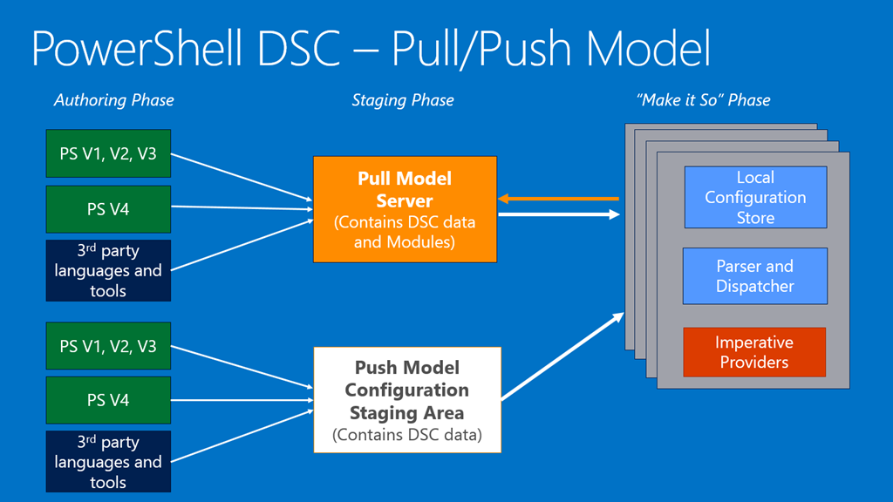
How does DSC work?

Slide 5
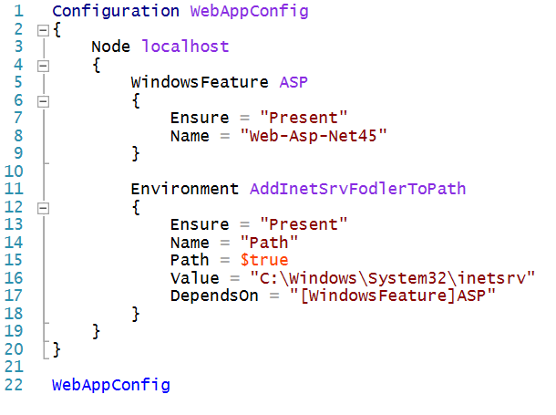
Configuration

Slide 6
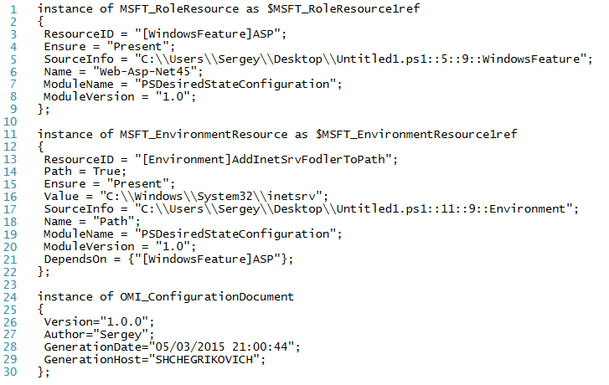
Managed Object Format

Slide 7
DSC Resources
Built-In
DSC Resource Kit Wave
Community
xActiveDirectory
xAzure
xChrome
xDnsServer
xMySql
xJEA
xWebAdministration
cFailOverCluster
WindowsProcess

Slide 8
Demos!
Demo #1 - PowerShell vs. PowerShell DSC
Create a file with PowerShell
Create a file with DSC
Explain the differences
Demo #2 – Installing SQL Server with DSC
Full install and config with DSC
Downloading and installing community resources
Using configuration data and server “role” concept
Allows for multiple nodes

